Slide 1
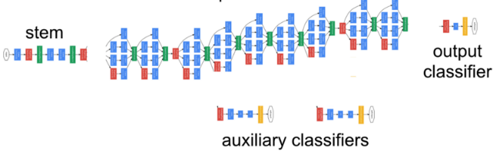

Predicting Image class/code with ML.NET + TensorFlow
TensorFlow: popular deep learning framework
Use a pretrained TensorFlow model:
e.g. exported from Azure Cognitive Services Custom Vision or model trained with Keras, etc.
Implemented as an Estimator in ML.NET
Data
Image Estimator
(Resize, etc.)
Data
Data
Estimator
Transformer
Data (single row)
Prediction Function
Data (single row)
Notes:
TensorFlow is the most popular deep learning library, that allows you to build custom (create train, evaluate) models in ML.NET.
We are going to use a pretrained model from TensorFlow, which means that it someone else trained this model and made it available on the internet.
The name of the model is inception and it takes an image and tells you which of the thousand classes is in it, e.g. cars, cats, breed of dogs
This is implemented as a Transformer in ML.NET, which means it takes in data transforms this data and outputs new data. In this case input is an image and it outputs the score of various classes.

Slide 2
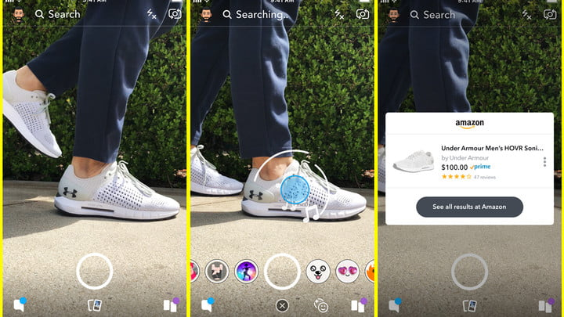
I saw this in the news…
“Use your Snapchat camera to buy Amazon products”
https://www.engadget.com/2018/09/24/snapchat-amazon-visual-search/
https://www.digitaltrends.com/social-media/snapchat-camera-shop-on-amazon/amp/
https://www.usatoday.com/videos/money/business/2018/09/25/soon-youll-able-use-your-snapchat-camera-buy-amazon-products/37933129/

Slide 3
Image Classification/Identification Demo architecture and implementation explanation

Slide 4
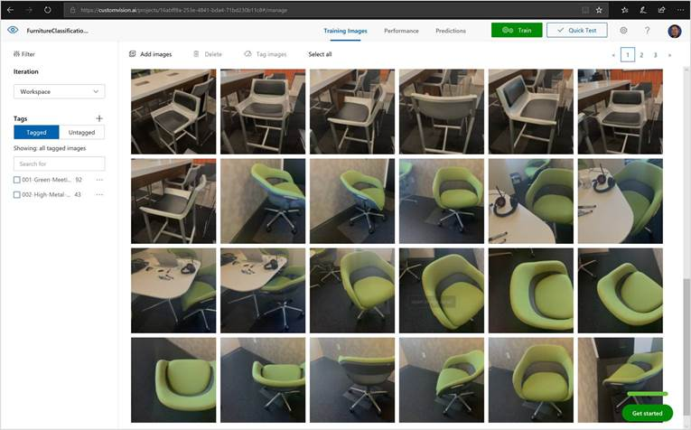

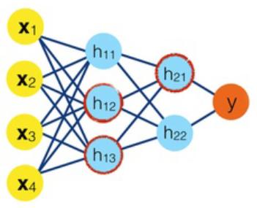
TensorFlow Model created/trained with
Cognitive Services Custom Vision
Created 2 labels, one per object/furniture-type trained in the model:
i. 001-Green-Meeting-Chair-Redmond
ii. 002-High-Metal-Chair-Redmond
Per object, I trained with almost 92 pictures for one chair and around 43 pictures for the other chair, as shown here at the https://customvision.ai/ portal on the right.
Finally, export the TensorFlow .pb model file and the labels .txt
TensorFlow .pb model file and the labels .txt
labels
.txt

Slide 5
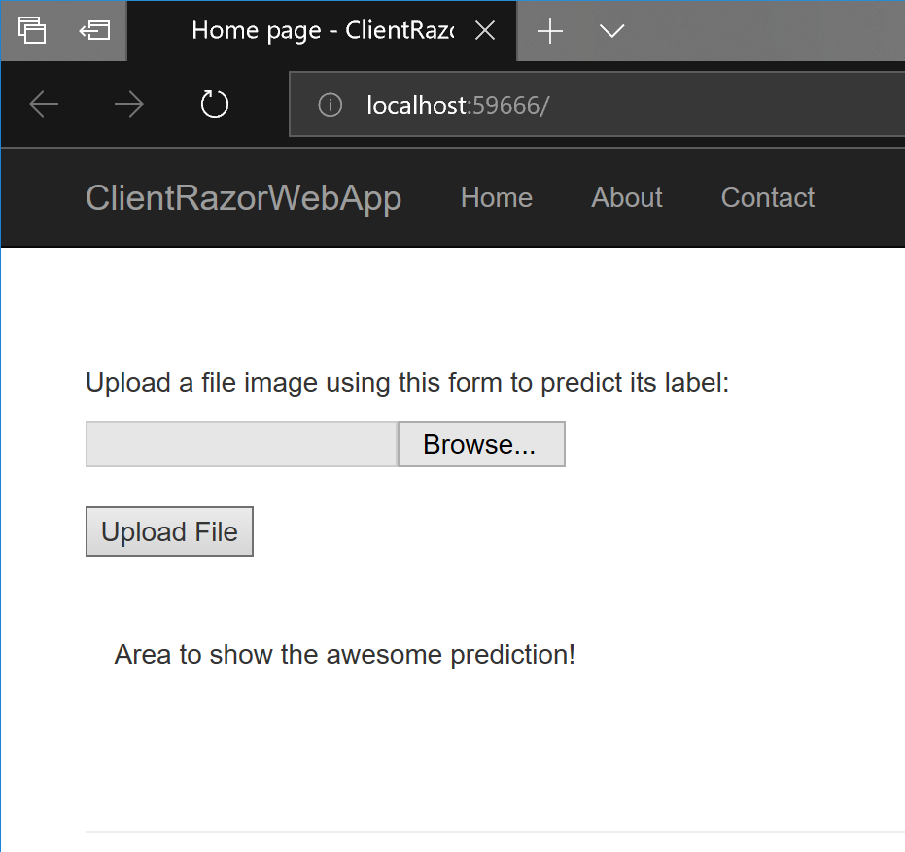

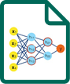


Demo app with ML.NET scoring a TensorFlow model
ASP.NET Core
Razor web app
ASP.NET Core
Web API
TensorFlow .pb
model file
and
labels .txt
Http
Http
Product code
Product code
ML.NET

Slide 6
Backup slides

Slide 7
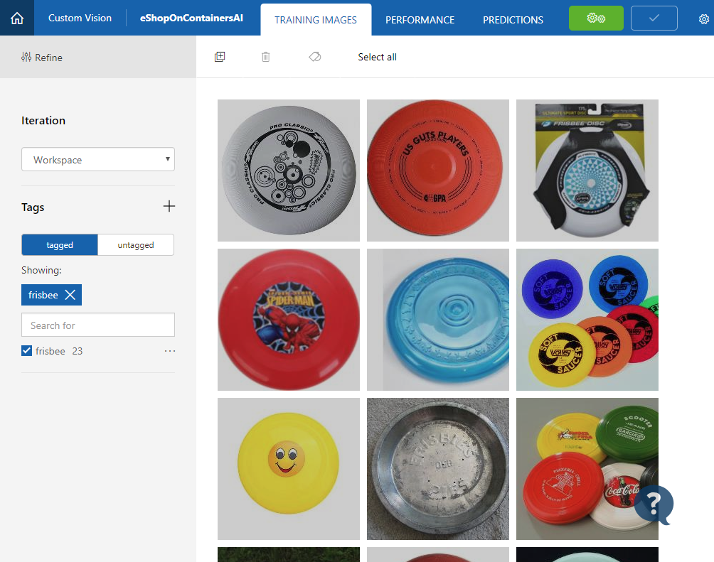
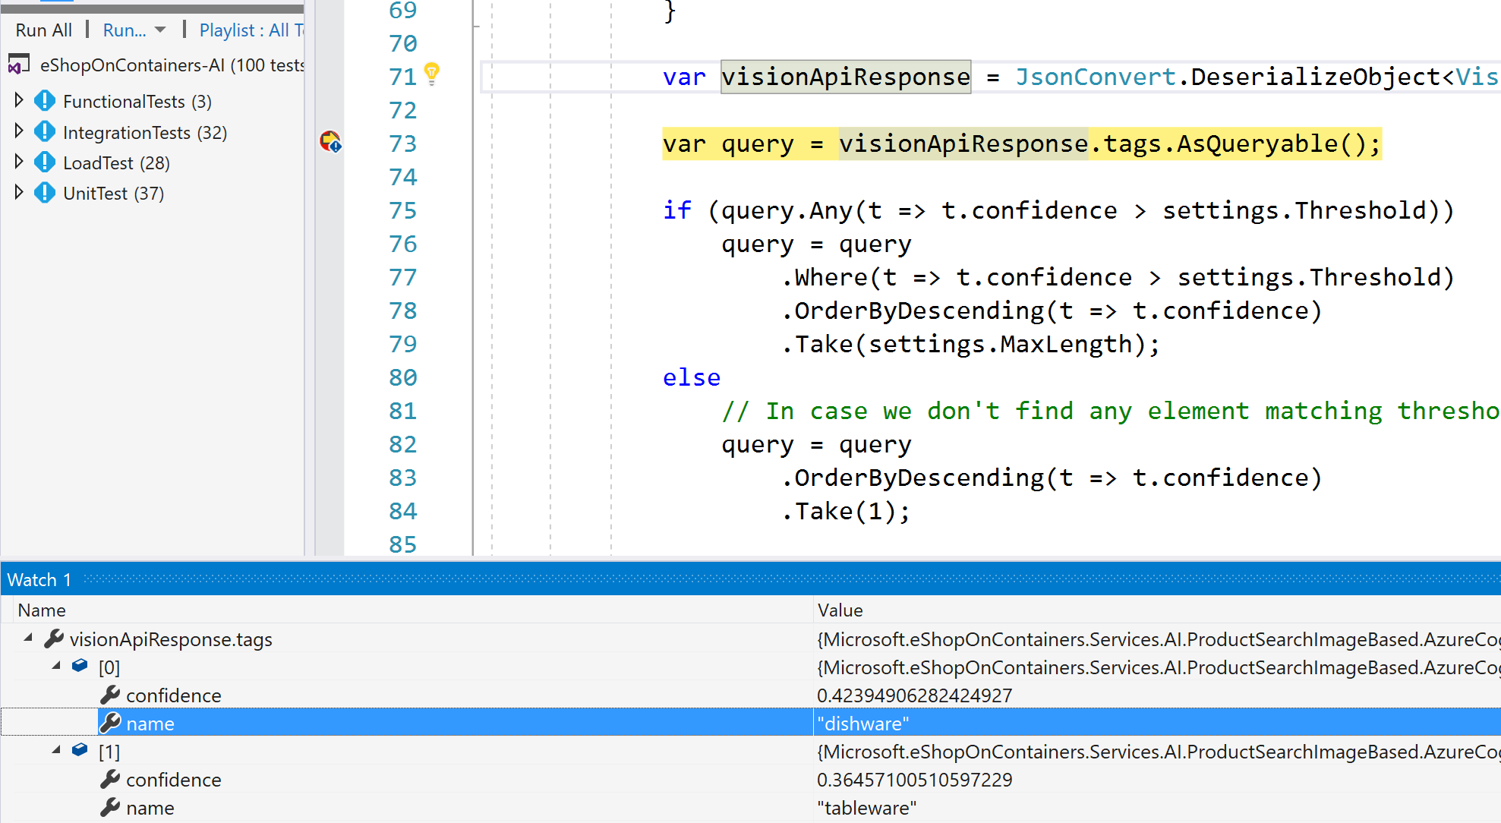
EXAMPLE: When to use “Azure Custom Vision”
If using Azure ComputerVision (which is always online), it doesn’t recognize a “Frisbee” picture. Recognizes it as “Dishware”, not a good identification → Need Custom Vision for these cases:

